Slide 1

Exploratory Data Analysis
Andrew Appuhamy

Slide 2

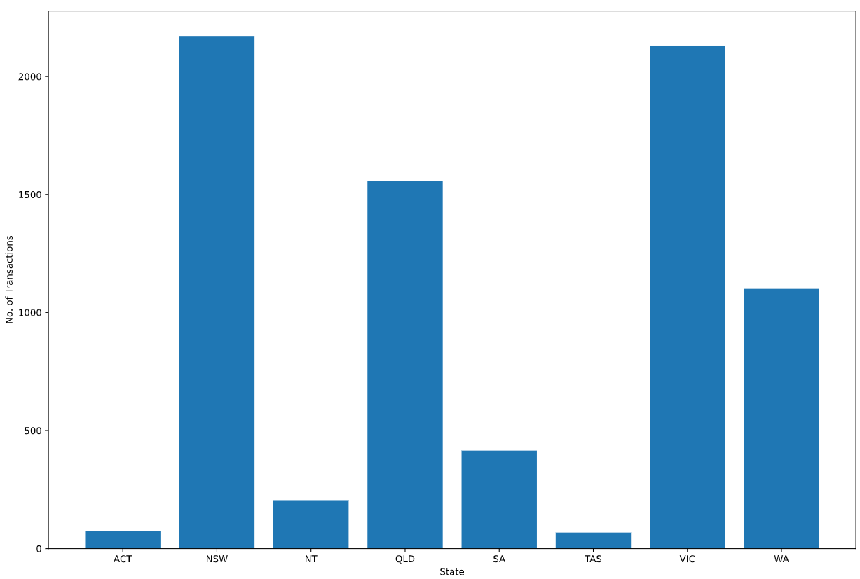
Transaction Amount Analysis
7717 total transactions occurred from August 1st to October 30th 2018.

Slide 3
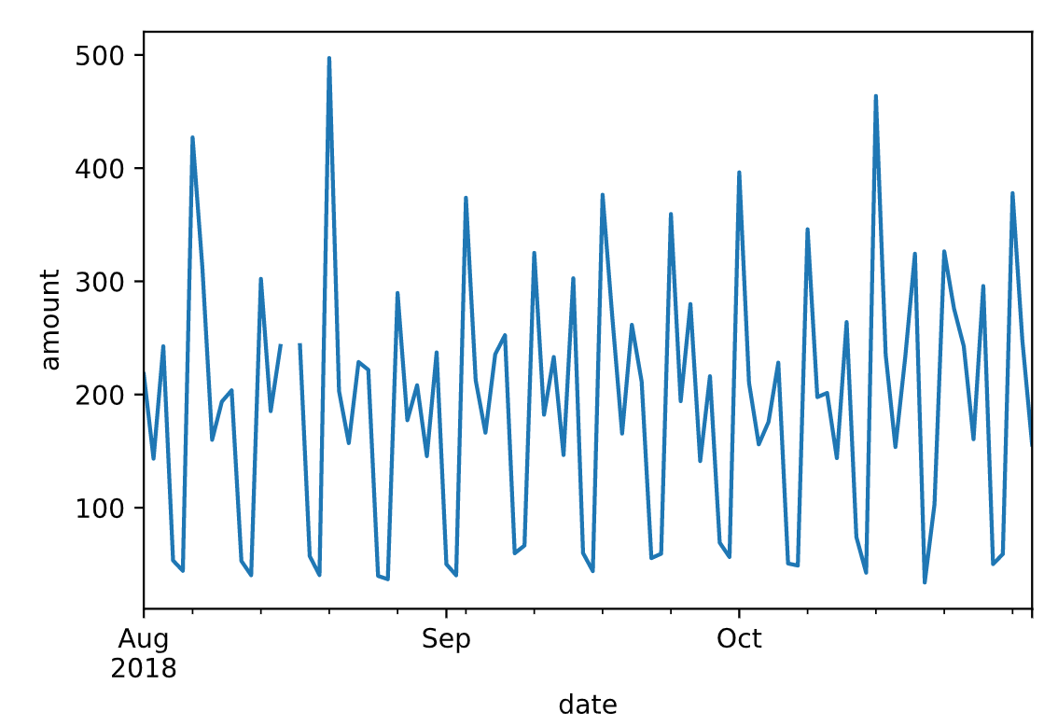
Title and Content Layout with Chart

Slide 4
Two Content Layout with Table
First bullet point here
Second bullet point here
Third bullet point here
Class | Group 1 | Group 2
Class 1 | 82 | 95
Class 2 | 76 | 88
Class 3 | 84 | 90

Slide 5
Title and Content Layout with SmartArt
Step 1 Title
Task description
Task description
Step 2 Title
Task description
Step 3 Title
Task description
Task description
Task description

Slide 6
Add a Slide Title - 1

